Slide 1
GEAR INSPECTION BRIEFING SEASON 2017-2018
SYDNEY BRANCH

Slide 2
GI Summary 2017/2018
Inspection slightly changed this year due to time saving Application & Fathers Day on Sunday.
All Clubs to be inspected on 2nd September, starting at Nth Bondi.
2x Teams
Bondi – Cronulla: Starting at Nth Bondi 0730
Matt Spooner (Branch LSM) /Simon Torsellini (Branch DOLE)
RNP
Peter Pearce (RNP Coordinator)

Slide 3
GI Schedule
Saturday 2nd September 2017
Club | Saturday
North Bondi | BREAKFAST & 7.30 am START
Bondi
Tamarama
Bronte
Clovelly
Coogee
Maroubra | LUNCH
South Maroubra
Wanda
Elouera
North Cronulla
Cronulla
Era | DONE SEPARATELY
Garie
Burning Palms

Slide 4
GUIDELINES – SYDNEY BRANCH
These guidelines are designed for Clubs and Support Services to assist with the efficient and effective inspection and assessment of ALL surf lifesaving equipment.
Important Notes for Clubs:
All equipment that is inspected MUST be entered in to Surfguard, this includes all Junior activities rescue equipment (Tubes, Boards and other) as well.
Points will be deducted for equipment presented and not displayed on checklist or equipment on checklist not being presented.
Equipment will be assessed as the SLSA Surfguard document NOT the NSW document.
Equipment presented must be endorsed by SLSA and MUST follow requirements set in SLSNSW Standard Operational Procedures.
All entries to Surfguard must be completed by the COB 29th August.

Slide 5
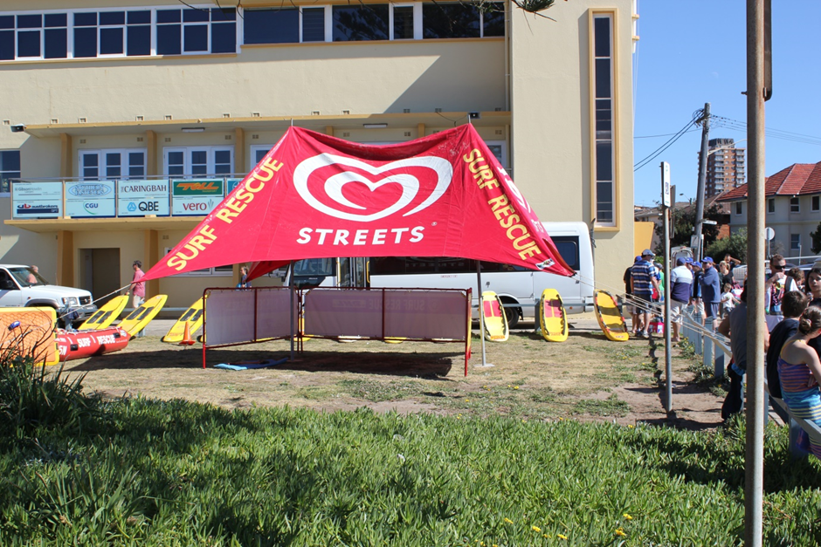
LIFE SAVING EQUIPMENT
Present equipment that is organised and in a safe manner – NO TRIP HAZARDS

Slide 6
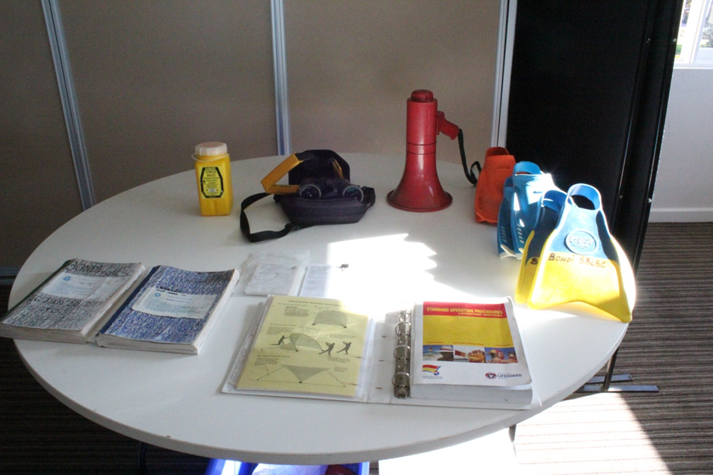
Patrol Equipment
All equipment is to be presented in a clean orderly arrangement
Do not go hunting for items as they are to be with checklist
There is no need to present patrol uniforms.

Slide 7
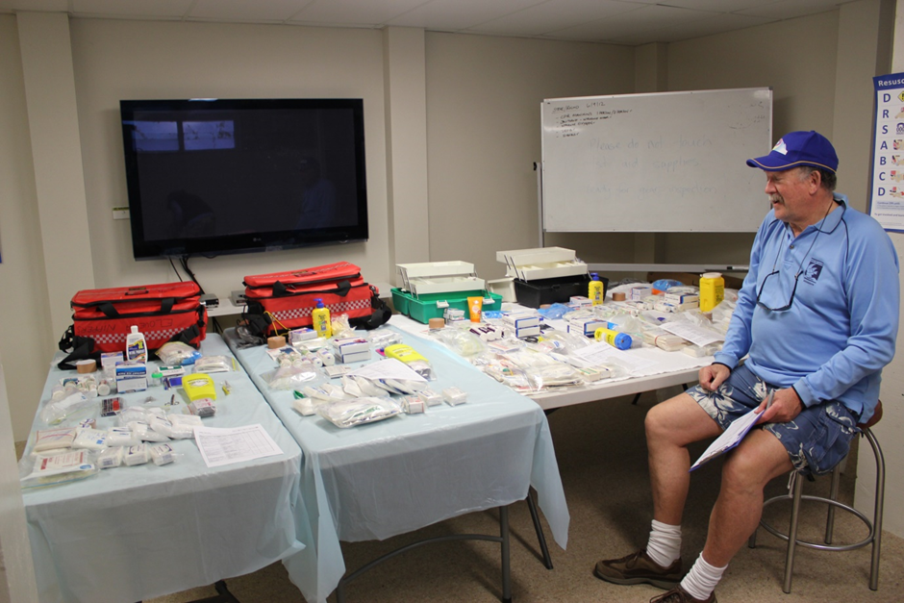
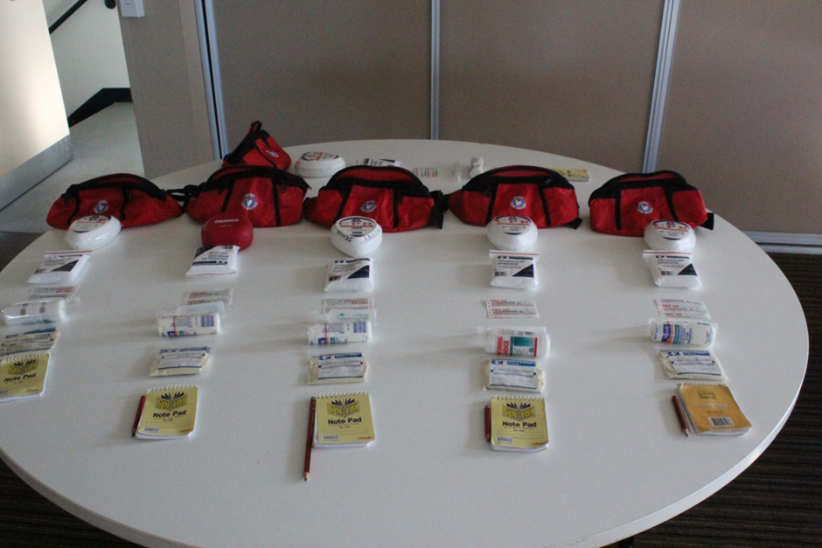
Have the items on the checklist in the checklist order
First aid rooms, portable kits, bum bags, defibrillators and oxy-viva units

Slide 8
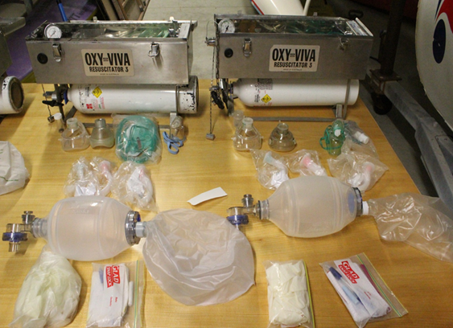
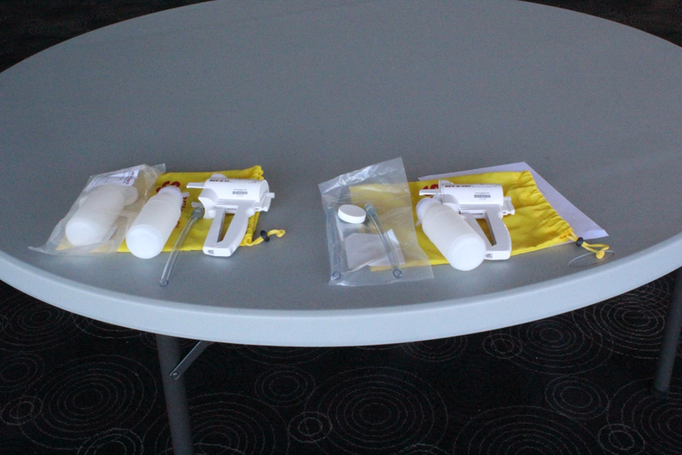
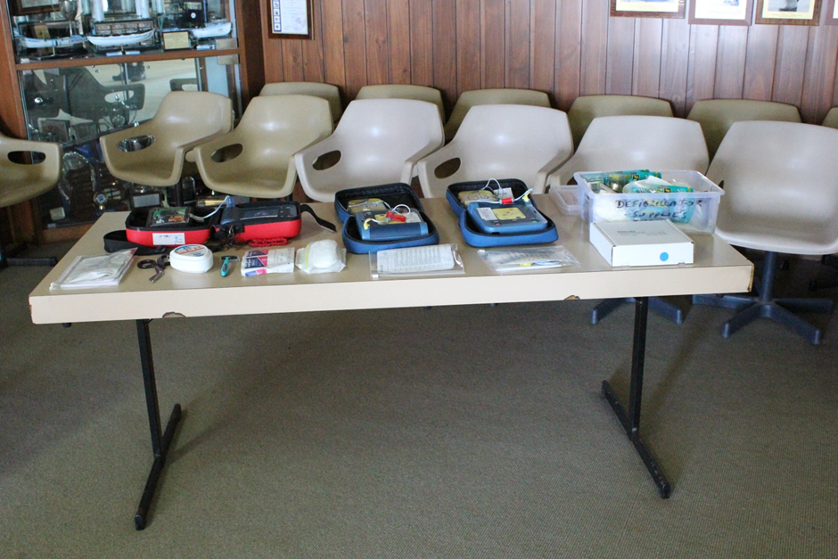
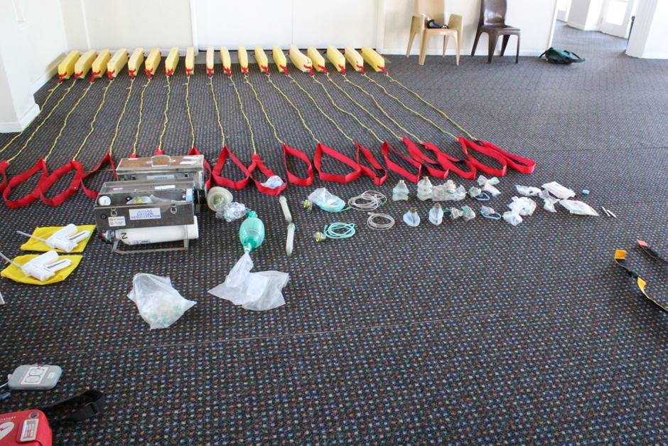

Slide 9
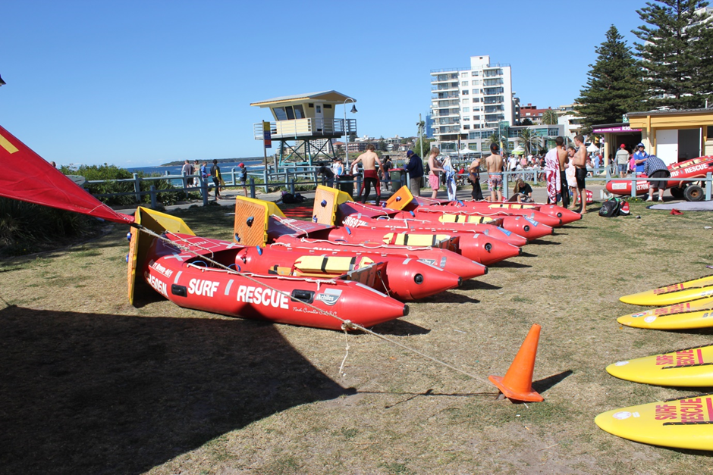
IRB’s
Presented by Director of Life Saving and Education – Simon Torsellini
Hulls
Ropes
Pontoons
Floor
Transom
Ropes
Fuel Cells

Slide 10
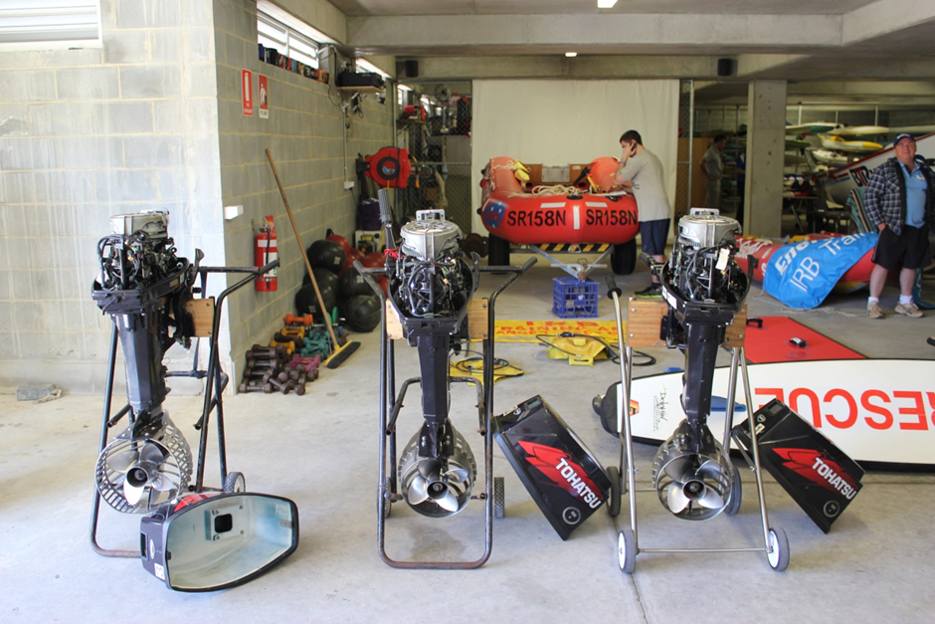
IRB’s

Slide 11
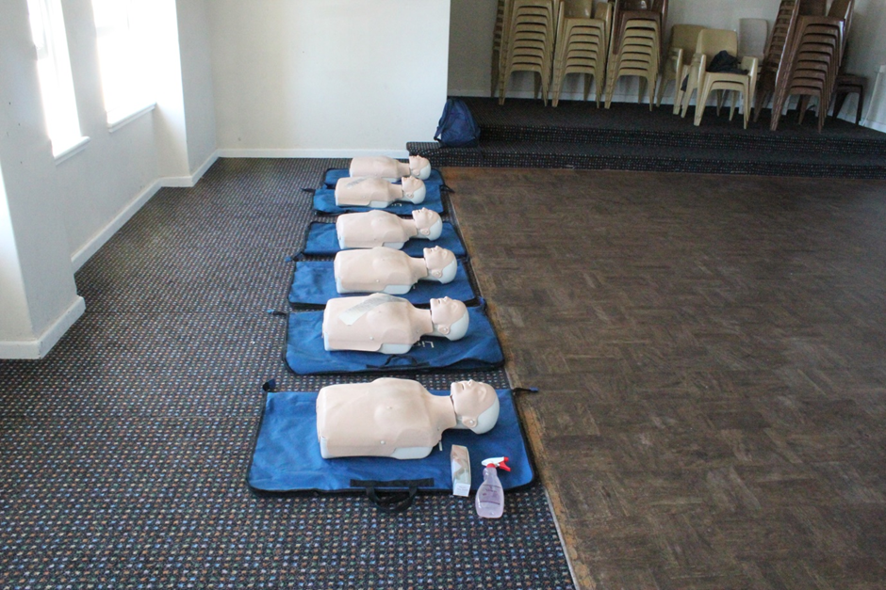
MANIKINS
All units to be displayed in numerical order and clearly identifiable
Units are Adult, child and infant
Defibrillator unit must have metal tape unbroken and in good operational order
Each unit will be tested for compressions and inflations
Club MUST provide clean and sterile masks for testing
Club should provide a sample of hygiene product in accordance with SLSA Cross Contamination Procedures

Slide 12
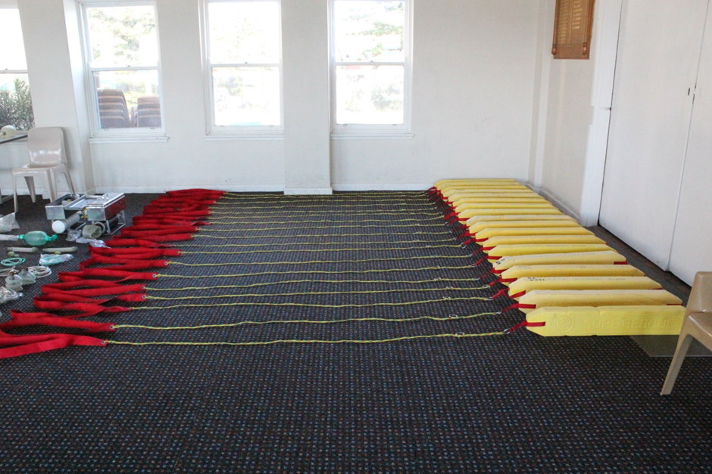
RESCUE TUBES
Clearly Identify units – Nippers or Life Saving?
Mark numerically
Present in numerical order

Slide 13
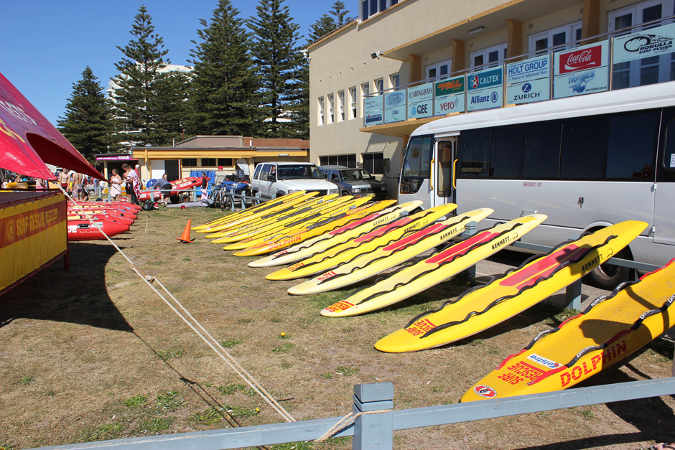
Rescue Boards
Present SLSA Endorsed equipment
Identify numerically and in order
Do not present damaged equipment

Slide 14
Spinal Equipment
Spinal Equipment
Spinal Boards
No damage to areas
Straps
Should accompany spinal boards
Need to be laid out and open
SLSA Approved
NOTE: CLUBS ARE NOT TO PRESENT SPINAL COLLARS FOR INSPECTION AS THEY ARE NO LONGER REQUIRED

Slide 15
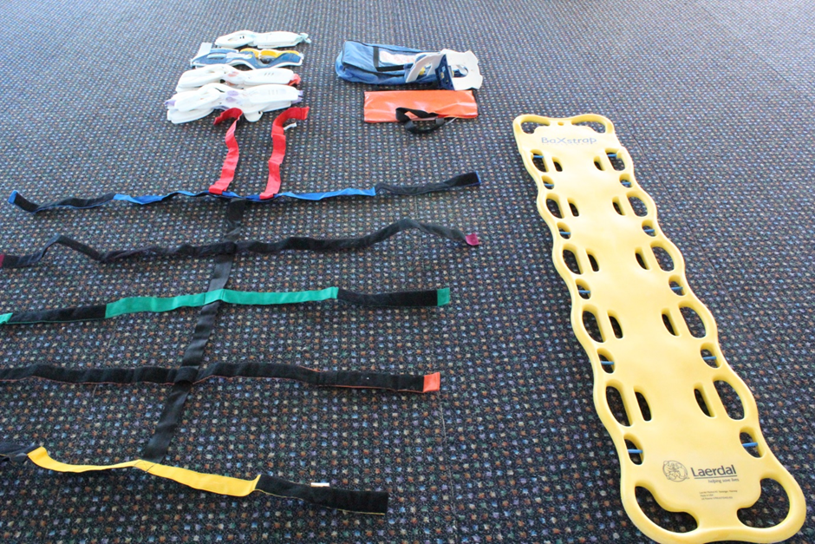
Spinal Equipment

Slide 16
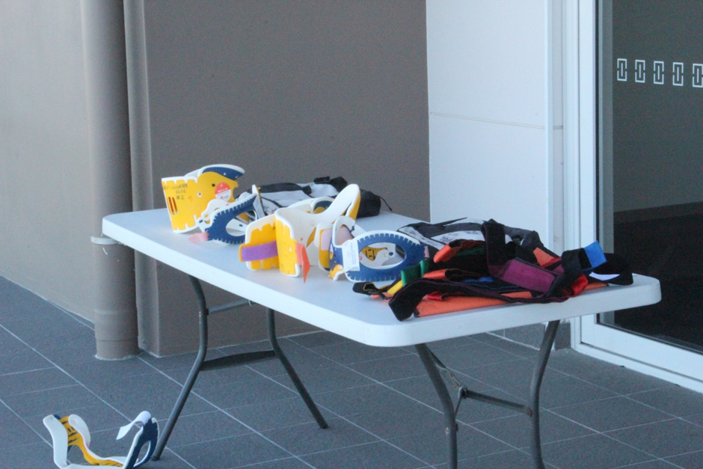
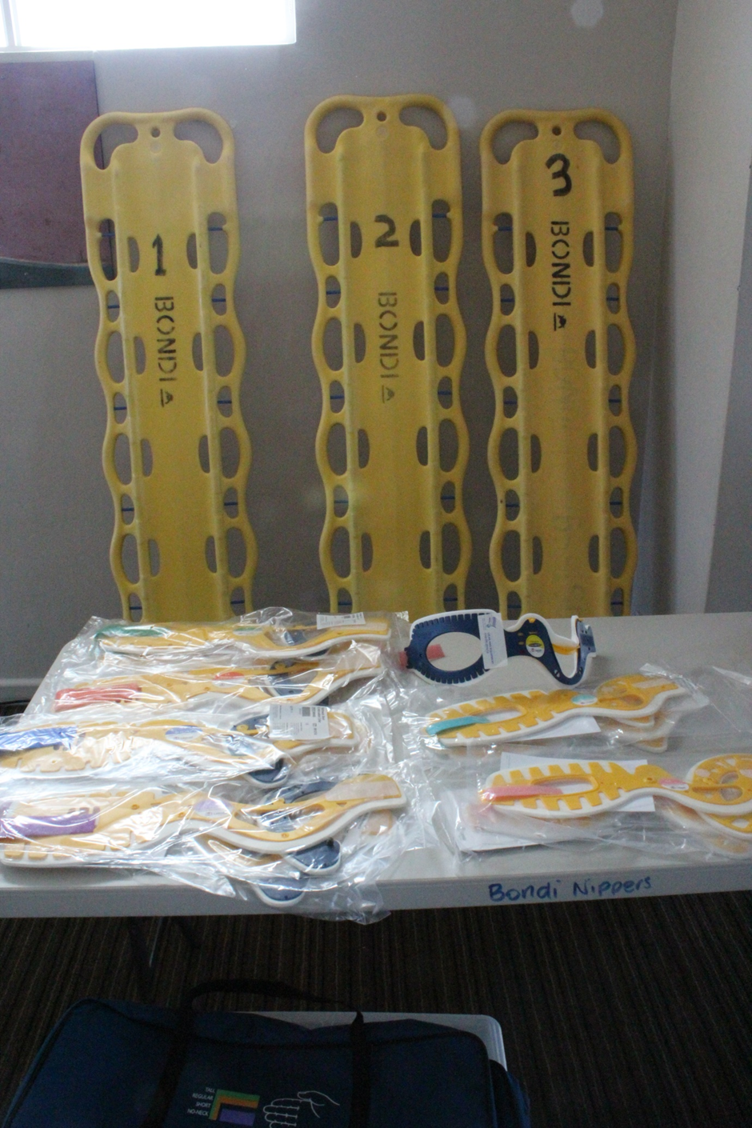
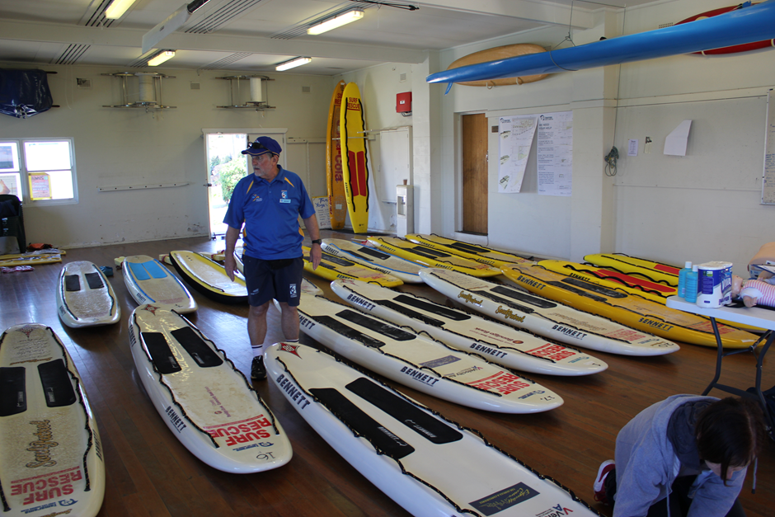
How NOT to Present Equipment
DO NOT PRESENT EQUIPMENT THAT LOOKS LIKE THIS

Slide 17
DOCUMENTATION
Compliance requirement with NSWSLS that All Lifesaving equipment meet the date for surfguard information – Clubs will be deemed Non-Compliant and may not be eligible for certain benefits
Circulars from both State and Sydney Branch will be present by Panel members for consultation
Gear Inspection Report
Original
Club Copy
Re-Inspections
To be completed within 14 days of Inspection
Date Inspection actually completed
Point Score
Evaluations
Deductions
Weightings
Final score
Equipment Evaluation
Pass - Meets all the requirements set out on the equipment list
Re-inspect - Minor fault or omission of equipment on list
Fail – Major fault or omission of equipment on list
Discard – Dangerous or equipment failure evident
Challenge of Assessed equipment by Inspection Panel members and Club
Decision final by Team Leaders on the day.

Slide 18
Thank you for your attendance

